Slide 1

Spring
4
Vocabulary and Ratios and Proportional Relationships
Stuy Prep
Lesson 26S4
Notes:
Slide designed by Benjamin Xie. Logo designed by Madeleine Villamil.

Slide 2
Welcome
Questions on Homework 3?
If not, here’s an icebreaker:
Close Reading and Expressions, Equations, and Inequalities
Would you rather be the best player on a team that always loses OR be the worst player on a team that always wins?
₊✩‧₊˚౨ৎ˚₊✩‧₊ ✮ ⋆ ˚｡⋆｡°✩⋆˚˖°
Notes:
Slide designed by Benjamin Xie. Logo designed by Madeleine Villamil.

Slide 3
abundant scarce reluctant eager vague valid
Spring
4
English Language Arts
Vocabulary
Aim: Understand vocabulary in context, and break down words into prefixes, suffixes, and roots.
Do Now: What is the difference between prefixes and suffixes?
abundant scarce condemn eager vague valid
Notes:
Slide designed by Amy Shrestha & Benjamin Xie. Logo designed by Madeleine Villamil.

Slide 4
Vocabulary in Context
In the Reading Comprehension section of the SHSAT, almost every passage will include a vocabulary in context question.
These questions will ask you to use context clues to choose the correct synonym for a word or to identify the purposes of certain words.
abundant scarce condemn eager vague valid
Notes:
Slide designed by Amy Shrestha. Logo designed by Madeleine Villamil.

Slide 5
Vocabulary in Context
Most words on the SHSAT are not highly technical or obscure and can easily be derived through the context in which they are used.
These questions often use wording like:
“...in line x the word xxxx most nearly means…”
“As used in line x, xxxx means…”
abundant scarce condemn eager vague valid
Notes:
Slide designed by Amy Shrestha. Logo designed by Madeleine Villamil.

Slide 6
Vocabulary in Context
Note that the primary meaning of the work is almost never the correct answer, so proceed cautiously when making this choice.
“The student offered a bright solution to a difficult problem.”
Bright: 1) reflecting light 2) intelligent or clever
The second definition is correct here.
abundant scarce condemn eager vague valid
Notes:
Slide designed by Amy Shrestha. Logo designed by Madeleine Villamil.

Slide 7
Strategies for Vocabulary
1) Read the whole paragraph containing the word(s) in the question (the context around the word).
Start by isolating the word and breaking down the sentence it appears in. Determine if it has a positive or negative connotation then move on to the entire paragraph.
abundant scarce condemn eager vague valid
Notes:
Slide designed by Amy Shrestha. Logo designed by Madeleine Villamil.

Slide 8
Strategies for Vocabulary
2) Predict the answer to the question before reading the answer choices.
Having in mind an idea of what the word means can be helpful, but the prediction must be logical (based on what you have previously read in the passage).
abundant scarce condemn eager vague valid
Notes:
Slide designed by Amy Shrestha. Logo designed by Madeleine Villamil.

Slide 9
Strategies for Vocabulary
3) Plugging in the answer choices to test them out.
This is very important. Words have multiple meanings and connotations, so plugging it back into the passage in the place of the original word will help you find the real meaning.
abundant scarce condemn eager vague valid
Notes:
Slide designed by Amy Shrestha. Logo designed by Madeleine Villamil.

Slide 10
Strategies for Vocabulary
4) Practicing reading comprehension, not vocabulary memorization.
Studying vocabulary is helpful, but the best way to improve your knowledge of vocabulary is through reading books or other literary works that use words of a higher grade level.
abundant scarce condemn eager vague valid
Notes:
Slide designed by Amy Shrestha. Logo designed by Madeleine Villamil.

Slide 11
Strategies for Vocabulary
5) Use your knowledge of roots and affixes to break down a word.
By breaking down a word, you will get a prefix, root, and suffix. These three elements of a word contain the entire meaning of the word.
abundant scarce condemn eager vague valid
Notes:
Slide designed by Amy Shrestha. Logo designed by Madeleine Villamil.

Slide 12
Root and Affixes
The root is the original form of the word. For example, in the word “predict,” the root dict means “to say.”
All words have one or more roots in it. You know you have found the root when it has a fixed meaning and it cannot be broken down further.
abundant scarce condemn eager vague valid
Notes:
Slide designed by Amy Shrestha. Logo designed by Madeleine Villamil.

Slide 13
Root and Affixes
Then, take out the prefixes and suffixes from the word. You can combine the meaning of the root word and the affixes to accurately guess the meaning of the new and unfamiliar word.
An affix is a group of letters added to a root to change its meaning. Two types:
A prefix comes before the root.
A suffix comes after the root.
abundant scarce condemn eager vague valid
Notes:
Slide designed by Amy Shrestha. Logo designed by Madeleine Villamil.

Slide 14
Root and Affixes
For example, the word “predict” has the prefix pre-, which means “before”. Then, combine it with the root dict, which means “to say.”
So you can conclude, “predict” means “to say before,” or to tell what will happen before it happens.
abundant scarce condemn eager vague valid
Notes:
Slide designed by Amy Shrestha. Logo designed by Madeleine Villamil.

Slide 15
Root and Affixes
Another word, “unhappiness” consists of a prefix, a root, and a suffix.
prefix: un- → means “not”
root: happy
suffix: -ness → means “the state of”
Unhappiness means the state of being not happy.
abundant scarce condemn eager vague valid
Notes:
Slide designed by Amy Shrestha. Logo designed by Madeleine Villamil.

Slide 16
Prefixes
Some common prefixes are listed below.
pre- → before (preview, predict)
re- → again (redo, rewrite)
un- → not (unhappy, unfair)
dis- → not / opposite of (disagree, disappear)
in- / im- / il- / ir- → not (incorrect, impossible, illegal, irregular)
non- → not (nonsense, nonfiction)
mis- → wrong / badly (mistake, mislead)
abundant scarce condemn eager vague valid
Notes:
Slide designed by Madeleine Villamil. Logo designed by Madeleine Villamil.

Slide 17
Prefixes
Some common prefixes are listed below.
over- → too much (overheat, overdo)
under- → too little (underpaid, underestimate)
inter- → between (international, interact)
trans- → across (transport, transfer)
sub- → under (submarine, subway)
bi- → two (bilingual, bicycle)
abundant scarce condemn eager vague valid
Notes:
Slide designed by Madeleine Villamil. Logo designed by Madeleine Villamil.

Slide 18
Suffixes
Some common suffixes are listed below.
-er / -or → person who (teacher, actor)
-ist → person who (artist, scientist)
-ness → state of (happiness, darkness)
-ful → full of (helpful, fearful)
-less → without (hopeless, fearless)
-ly → in a certain way (quickly, slowly)
-able / -ible → able to be (readable, visible)
abundant scarce condemn eager vague valid
Notes:
Slide designed by Madeleine Villamil. Logo designed by Madeleine Villamil.

Slide 19
Suffixes
-ant / -ee → person / role
-fy / -ify → turn into
-ion / -tude → state, process
-er / -or → a person who
-ism → belief or condition
What’s the difference between tutee and tutor? Break the word down into its root, suffix, and prefix.
abundant scarce condemn eager vague valid
Notes:
Slide designed by Madeleine Villamil. Logo designed by Madeleine Villamil.

Slide 20
Suffixes
-ant / -ee → person / role
-fy / -ify → turn into
-ion / -tude → state, process
-er / -or → a person who
-ism → belief or condition
tutee
root: tut (to teach/guide)
suffix: -ee
tutor
root: tut
suffix: -or
abundant scarce condemn eager vague valid
Notes:
Slide designed by Madeleine Villamil. Logo designed by Madeleine Villamil.

Slide 21
Suffixes
-ant / -ee → person / role
-fy / -ify → turn into
-ion / -tude → state, process
-er / -or → a person who
-ism → belief or condition
tutee
a person who is being taught
tutor
a person who teaches or guides
abundant scarce condemn eager vague valid
Notes:
Slide designed by Madeleine Villamil. Logo designed by Madeleine Villamil.

Slide 22
Root and Affixes
You might ask: Do I need to memorize ALL of these?
No! You probably already know some of these!
And if there’s an affix that you don’t already know, you can look at words with the same affix and/or root to get a clue!
abundant scarce condemn eager vague valid
Notes:
Slide designed by Madeleine Villamil. Logo designed by Madeleine Villamil.

Slide 23
Root and Affixes
secede → suffix -cede
precede → come before (something) in time
recede → go or move back or further away
Therefore, -cede probably has something to do with going/withdrawing (“secede” means to withdraw from an organization).
abundant scarce condemn eager vague valid
Notes:
Slide designed by Madeleine Villamil. Logo designed by Madeleine Villamil.

Slide 24
Vocabulary in Context
Read 🅐 “Excerpt 1.”
Read the entire passage once first and annotate each passage. Predict the answer for the bolded word. Plug in answer choices and eliminate.
As used in line 27, “directed” most nearly means?
A) trained.
B) aimed.
C) guided.
D) addressed.
abundant scarce condemn eager vague valid
Notes:
Slide designed by Amy Shrestha. Logo designed by Madeleine Villamil.

Slide 25
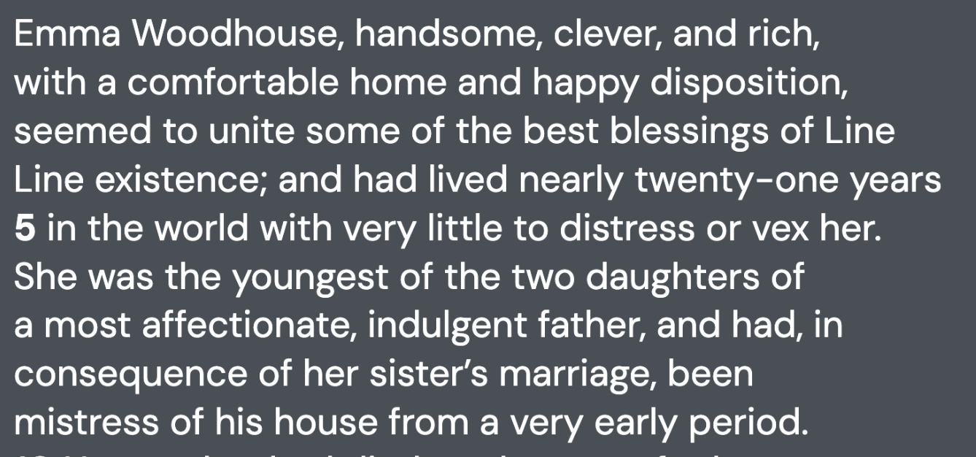
Vocabulary in Context
Emma is a young woman
who seems to have everything: good looks, the smarts and money.
She lives with her indulgent father and was in charge of the house after her older sister married (“mistress of his house”).
abundant scarce condemn eager vague valid
Notes:
Slide designed by Amy Shrestha. Logo designed by Madeleine Villamil.

Slide 26
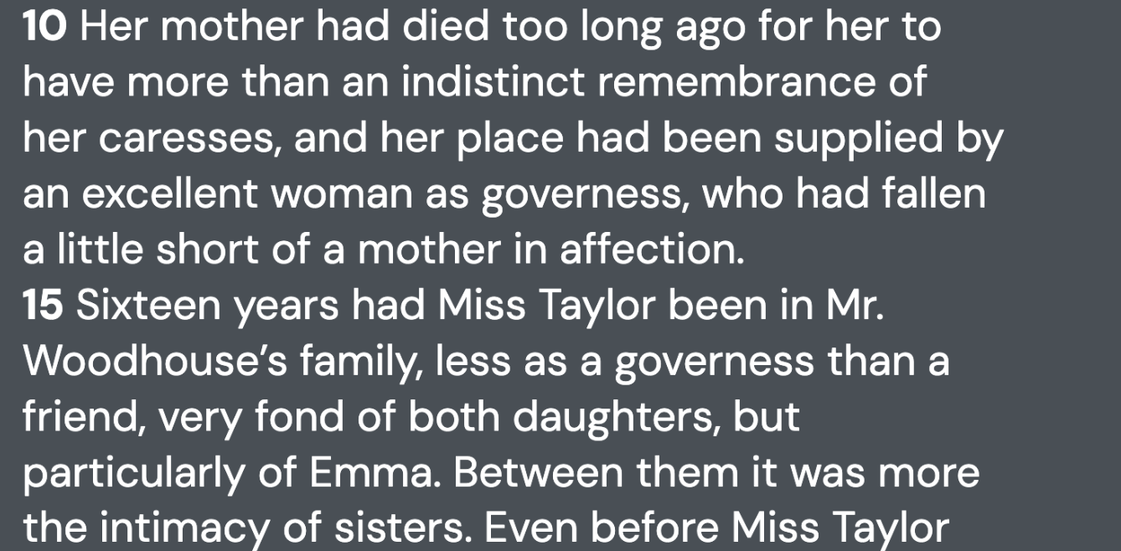
Vocabulary in Context
Her mother died too early in her childhood, so she only has a vague recollection. Instead, the governess was her mother figure.
Miss Taylor, the governess, acted more like a close friend or an older sister to Emma.
abundant scarce condemn eager vague valid
Notes:
Slide designed by Amy Shrestha. Logo designed by Madeleine Villamil.

Slide 27
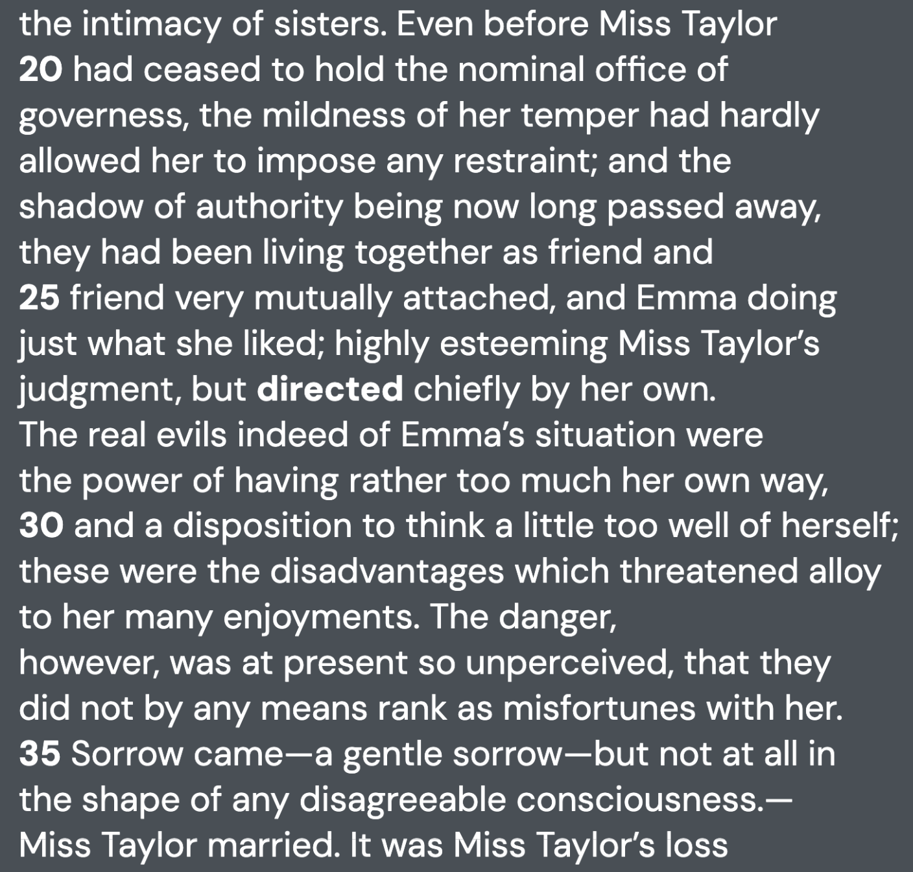
Vocabulary in Context
Read 🅐 “Excerpt 1.”
C) guided.
Miss Taylor was kind when she was governess, but after she left her job, she was still close with Emma. In their relationship, Emma was free to do as she liked but still respected Miss Taylor’s own judgements, though it’s mainly led by her own. When Miss Taylor got married, Emma felt sad, but did not disagree with her decision.
abundant scarce condemn eager vague valid
Notes:
Slide designed by Amy Shrestha. Logo designed by Madeleine Villamil.

Slide 28
Vocabulary in Context
Read 🅐 “Excerpt 1.”
As used in line 54, “want” most nearly means
A) desire.
B) lack.
C) requirement.
D) request.
abundant scarce condemn eager vague valid
Notes:
Slide designed by Amy Shrestha. Logo designed by Madeleine Villamil.

Slide 29
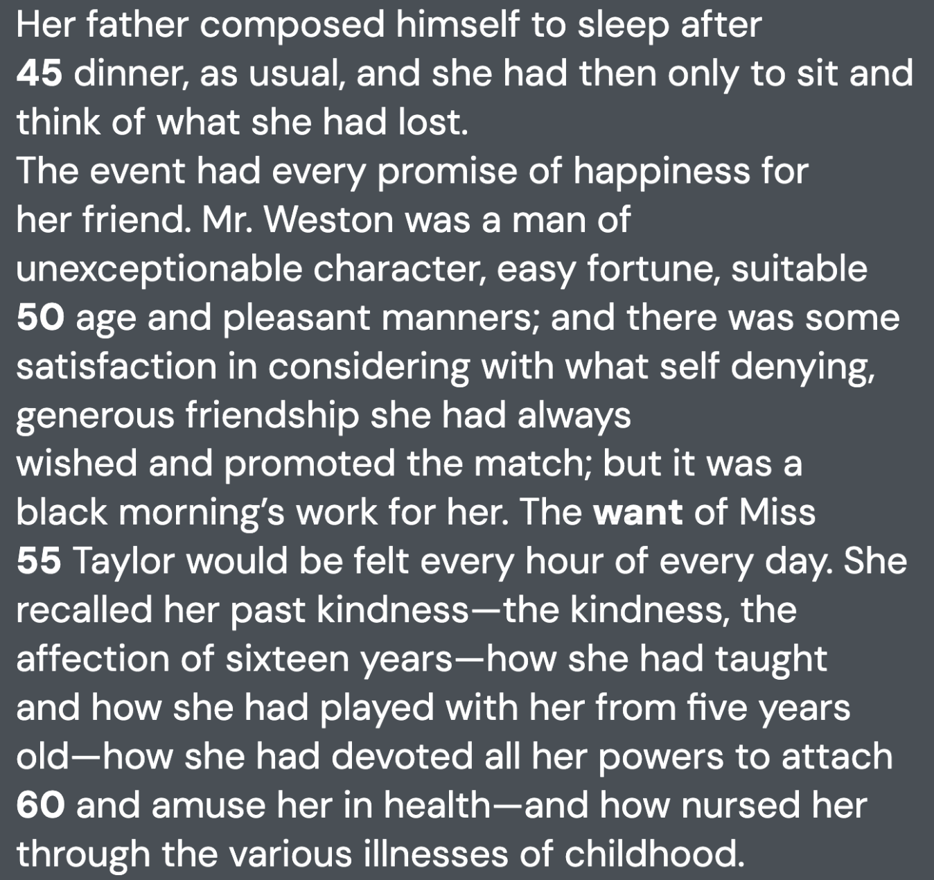
Vocabulary in Context
Read 🅐 “Excerpt 1.”
B) lack.
During Miss Taylor’s wedding, Emma felt lonely, dining with her father without her friend Miss Taylor. Although her husband, Mr. Weston was an exceptional person and a good match for Miss Taylor, Emma is deeply saddened by Miss Taylor’s absence in her life, and even feels selfish. Still, Emma felt comfort knowing that she supported the marriage genuinely.
abundant scarce condemn eager vague valid
Notes:
Slide designed by Amy Shrestha. Logo designed by Madeleine Villamil.

Slide 30
Vocabulary in Context
Read 🅑 “Excerpt from The Necklace.”
As it is used at the beginning of paragraph 1, the word “blundered” most nearly means:
A) tripped.
B) erred.
C) connived.
D) mistook.
abundant scarce condemn eager vague valid
Notes:
Slide designed by Amy Shrestha. Logo designed by Madeleine Villamil.

Slide 31
Vocabulary in Context
Read 🅑.
B) erred
“...as fate had blundered over her” means fate had made a mistake in placing her in a poor family despite her beauty. Despite being “pretty and charming,” she was born “into a family of artisans” and “had no marriage portion,” or any other opportunities to rise in class. “Erred” means made an error, which matches the meaning of blundered.
abundant scarce condemn eager vague valid
Notes:
Slide designed by Amy Shrestha. Logo designed by Madeleine Villamil.

Slide 32
Vocabulary in Context
Read 🅑.
B) erred
“Tripped” is a physical action, and fate, being an intangible concept, cannot do actions. “Connived” means secretly plotted, and there is no evidence that proves fate was making her born in a lower class on purpose. Finally, “mistook” does not match the grammar in the passage: “as though fate had mistook over her.”
abundant scarce condemn eager vague valid
Notes:
Slide designed by Amy Shrestha. Logo designed by Madeleine Villamil.

Slide 33
Vocabulary in Context
Read 🅑 “Excerpt from The Necklace.”
As it is used in paragraph two, the word mean in the phrase, "from its mean walls" most nearly means:
A) callous.
B) menial.
C) snide.
D) stingy.
abundant scarce condemn eager vague valid
Notes:
Slide designed by Amy Shrestha. Logo designed by Madeleine Villamil.

Slide 34
Vocabulary in Context
Read 🅑.
D) stingy
“She suffered from the poorness of her house, from its mean walls, worn chairs, and ugly curtains.” This description describe the house as cheap, poor, and lacking in quality. “Mean” here would mean poor, or poorly-made walls. “Stingy” works best here, as it metaphorically describes the walls as something that looks like it was made with little money.
abundant scarce condemn eager vague valid
Notes:
Slide designed by Amy Shrestha. Logo designed by Madeleine Villamil.

Slide 35
Vocabulary in Context
Read 🅑.
D) stingy
“Callous” means emotionally insensitive, and doesn’t describe walls or the condition of them. “Menial” means low-status labor, and cannot be applied to objects. “Snide” is a sarcastic or insulting tone that is not used for visual description of an object.
abundant scarce condemn eager vague valid
Notes:
Slide designed by Amy Shrestha. Logo designed by Madeleine Villamil.

Slide 36
Summary
When encountering a vocabulary in context question, follow these steps:
Reread the context around the word(s).
Predict the answer for the question.
Plug in answer choices in place of the word in the passage.
Break the word down to root(s) and affixes.
abundant scarce condemn eager vague valid
Notes:
Slide designed by Madeleine Villamil. Logo designed by Madeleine Villamil.

Slide 37
2:1 ¾ to 4:7 ½ rate x 2:5 y
Spring
4
Mathematics
Ratios and Proportional Relationships
Aim: Describe points on the equations of proportional relationships using ratios.
Do Now: What is a fraction?
2:1 ¾ to 4:7 ½ rate x 2:5 y
Notes:
Slide designed by Benjamin Xie.

Slide 38
Ratios
The ratio of students to tables in the cafeteria is 7:2, because for every 7 students there are 2 tables.
For every vote candidate A received, candidate C received three votes.
These are ratios.
How many of x can match with how many of y?
C
C
A
A
C
C
C
C
2:1 ¾ to 4:7 ½ rate x 2:5 y
Notes:
Standard approximation: NY-6.RP.1
Slide designed by Benjamin Xie. Logo designed by Madeleine Villamil.
Ratios are kinda hard for me to describe so here’s some examples instead

Slide 39
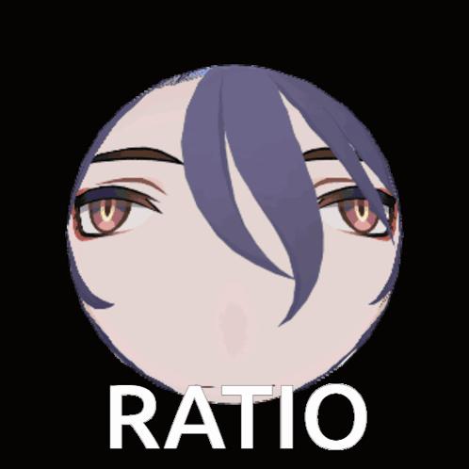
Ratios
We can represent ratios in many ways.
For every 7 students, there are 2 tables.
7:2
7 (students) to 2 (tables)
7 (students) per 2 (tables)
7⁄2
2:1 ¾ to 4:7 ½ rate x 2:5 y
Notes:
Standard approximation: NY-6.RP.1
Slide designed by Benjamin Xie. Logo designed by Madeleine Villamil.

Slide 40
Unit Rates
That fraction (7⁄2) is really how many units of the numerator (students) can fit in one unit of the denominator (tables).
This number is called the unit rate.
Rates imply an unchanging relationship between two things (e.g., 7⁄2 students per table will still be the unit rate even if we get more tables).
2:1 ¾ to 4:7 ½ rate x 2:5 y
Notes:
Standard approximation: NY-6.RP.2, NY-7.RP.1
Slide designed by Benjamin Xie. Logo designed by Madeleine Villamil.

Slide 41
Ratio Reasoning
We can use equivalent fractions or unit rates to find how many students could fill y tables.
For every 7 students, there are 2 tables.
If we have 6 tables . . .
7⁄2 = 21⁄6
or
7⁄2 per table is the unit rate
7⁄2 × 6 tables = 21 students
2:1 ¾ to 4:7 ½ rate x 2:5 y
Notes:
Standard approximation: NY-6.RP.3
Slide designed by Benjamin Xie. Logo designed by Madeleine Villamil.

Slide 42
Ratio Reasoning
We can think of percentages as rates per 100.
50.78% of NYC voters voted for Zohran Mamdani in 2025.
Out of every 100 NYC voters in 2025, 50.78 voted for Mamdani.
2:1 ¾ to 4:7 ½ rate x 2:5 y
Notes:
Standard approximation: NY-6.RP.3
Slide designed by Benjamin Xie. Logo designed by Madeleine Villamil.

Slide 43
Ratio Reasoning
When you’re converting between units of measurement, you’re given a ratio, right? You’ve secretly been using ratios already!
How many hours is 270 minutes?
60 minutes per hour
60⁄1 = 270⁄3.5
2:1 ¾ to 4:7 ½ rate x 2:5 y
Notes:
Standard approximation: NY-6.RP.3
Slide designed by Benjamin Xie. Logo designed by Madeleine Villamil.

Slide 44
Ratio Reasoning
Two trains start 300 miles apart and travel toward each other. One travels at 60 mph, the other at 40 mph. How long will it take for them to meet?
The trains get 100 miles closer to each other per hour.
1 hour
100 miles
×
300 miles
=
3 hours
2:1 ¾ to 4:7 ½ rate x 2:5 y
Notes:
Standard approximation: NY-6.RP.3
Slide designed by Benjamin Xie. Logo designed by Madeleine Villamil.

Slide 45
Proportional Relationships
So far, we’ve found equivalent ratios because we’ve been assuming that everything is in a proportional relationship, but what is it?
Two things being proportional means that you can make a proportion with all of the ratios (in their relationship). This means that you can set all of the ratios equal to each other.
2:1 ¾ to 4:7 ½ rate x 2:5 y
Notes:
Standard approximation: NY-7.RP.2
Slide designed by Benjamin Xie. Logo designed by Madeleine Villamil.

Slide 46
Proportional Relationships
Each cheeseburger costs $4.50.
The number of cheeseburgers, x, and the price, y, are proportional.
The price will always be 4.50 times the number of cheeseburgers: y = 4.50x
This is in the form y = kx, where k is the constant of proportionality (i.e., the unit rate).
2:1 ¾ to 4:7 ½ rate x 2:5 y
Notes:
Standard approximation: NY-7.RP.2
Slide designed by Benjamin Xie. Logo designed by Madeleine Villamil.

Slide 47
Proportional Relationships
y
This proportional relationship has a graph that is straight and passes through the origin.
A point on this graph—like (2, 9.00) —means that for 2 cheeseburgers costs $9.00. The point (1, 4.50) tells you the constant of proportionality.
12
9
6
3
O
1
2
3
4
x
2:1 ¾ to 4:7 ½ rate x 2:5 y
Notes:
Standard approximation: NY-7.RP.2
Slide designed by Benjamin Xie. Logo designed by Madeleine Villamil.

Slide 48
Independent and Dependent Variables
y
Why is cheeseburgers x and price y?
By convention, we assign the independent variable—the one that we can change on its own—x, and the dependent variable—the one affected by the independent variable, y.
12
9
6
3
O
1
2
3
4
x
2:1 ¾ to 4:7 ½ rate x 2:5 y
Notes:
Standard approximation: NY-6.EE.9
Slide designed by Benjamin Xie. Logo designed by Madeleine Villamil.

Slide 49
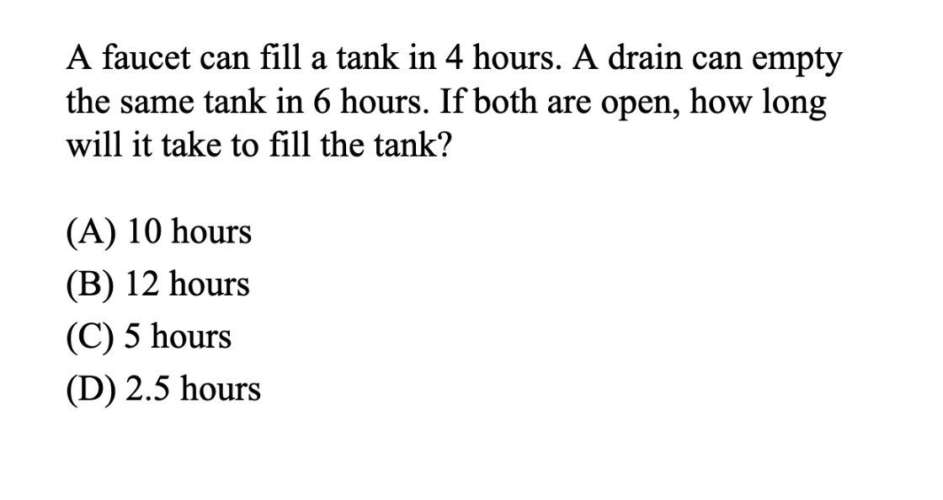

Slide 50
Classic Work/Rate Problem (2)
Faucet fill rate: 1 tank / 4 hours (or 1/4)
Drain rate: 1 tank / 6 hours (or 1/6)
Working together, the net fill rate is:
1 tank / 4 hours - 1 tank / 6 hours
= 3 tanks / 12 hours - 2 tanks / 12 hours
= 1 tank / 12 hours
We want to know how many hours it takes both workers to do 1 wall so we can use the work rate formula.
Time = Work / Rate
= 1 tank / (1 tank / 12 hours)
= 12 hours

Slide 51
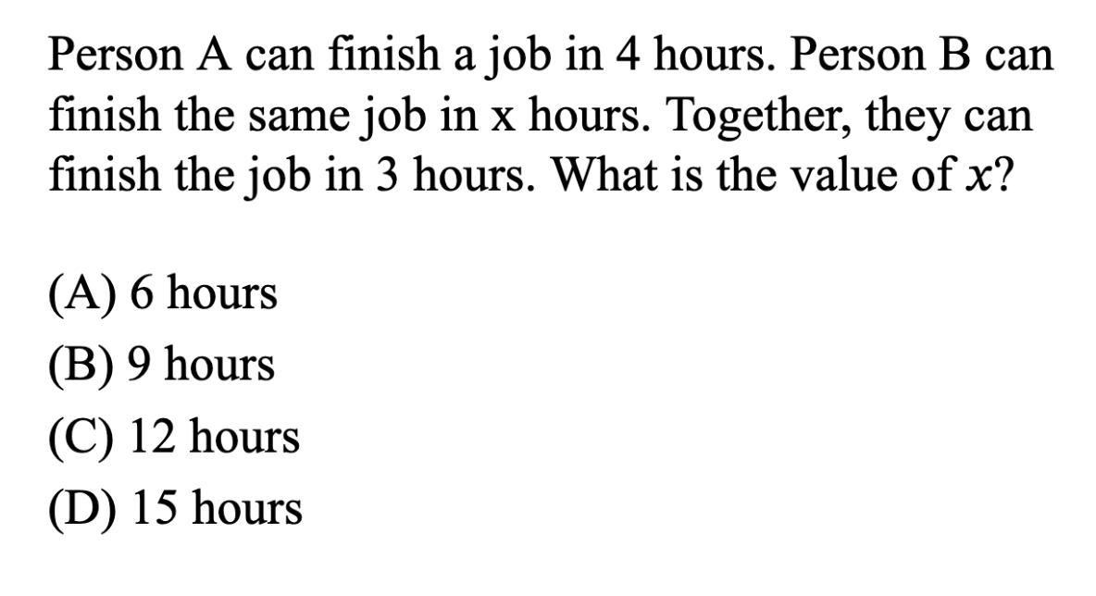
(if there’s time)

Slide 52
Classic Work/Rate Problem (3)
(if there’s time)
Person A: 1 job / 4 hours (or 1/4)
Person B: 1 job / x hours (or 1/x)
Working together, the net work rate is: 1 job / 3 hours
1 job / 3 hours = 1 job / 4 hours + 1 job / x hours 1/3 = 1/4 + 1/x
1 job / 3 hours - 1 job / 4 hours = 1 job / x hours 1/3 - 1/4 = 1/x
4 jobs / 12 hours - 3 jobs / 12 hours = 1 job / x hours 4/12 - 3/12 = 1/x
1 job / 12 hours = 1 job / x hours 1/12 = 1/x
x hours = 12 hours x = 12

Slide 53
Spring
4
Thanks for coming! Questions?
SHSAT Vocabulary Quizlet
Notes:
Slide designed by Benjamin Xie. Logo designed by Madeleine Villamil.

